Slide 1
Justifying terms of a sequence
Sequences

Slide 2
how to use Oak lessons

Slide 3
I can determine whether a number is a term in a given arithmetic sequence.

Slide 4
An arithmetic (or linear) sequence is a sequence where the difference between successive terms is a constant.
Example:
5, 9, 13, 17, … is an arithmetic sequence. A constant difference of +4 between terms.
1, 2, 4, 8, … is not arithmetic. The difference between terms is not constant.

Slide 5

Justifying terms of a sequence
Using features of a sequence
Using a graphical representation
Using the n^{th} term

Slide 6
Using features of a sequence
We can use the features of an arithmetic sequence to justify whether a given number is a term in that sequence or not.
Will 4583 be a term in the arithmetic sequence starting 2, 8, 14, 20, 26, …?
How might we justify our answer?
4583 will not be in the sequence because it is an odd number. 2, 8, 14, 20, 26, … are all even numbers. The common difference is even, so the terms will always remain even.

Slide 7

Using features of a sequence
897 is in the arithmetic sequence starting -16, -6, 4, 14, …
897 ends in 7, not 4
Not a detailed enough justification.
The sequence has a common difference of +10 therefore all subsequent positive terms will end with a 4 in the ones column. 897 does not have a ones digit of 4.

Slide 8
Using features of a sequence
Will the arithmetic sequences 5n + 13 and 10n − 28 ever share a common term?
No. They will never have a common term.
There are lots of ways we might show this mathematically. One simple way, is to consider the features of the first few terms then justify.
The sequence 5n + 13 is a translation of the sequence 5n, therefore it will always end with a 3 or an 8 in the ones position.
The sequence 10n − 28 is a translation of the sequence 10n, therefore all positive terms will continue to end with a 2 in the ones position.

Slide 9
Using features of a sequence
Which statement is true of the sequences 5n − 4 and 20n − 1 ?
5n − 4: 1, 6, 11, 16, …
20n − 1: 19, 39, 59, 79 …
They share a common term.
They do not share a common term.
5n − 4 is a translation by -4 of 5n therefore will always end in 1 or 6.
20n − 1 is a translation by -1 of 20n therefore will always end in 9.
We can’t tell if there is a common term or not.

Slide 10
Using features of a sequence
Sometimes the justification can be about increasing or decreasing sequences.
Will 16.879 ever be in the arithmetic sequence starting 11.758, 11.635, 11.512, 11.389, … ?
No. It’s a decreasing sequence and 16.879 is greater than the first term.

Slide 11

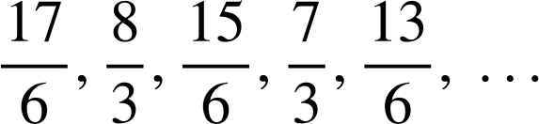
Using features of a sequence
is in the arithmetic sequence
We could make a common denominator of sixths so it might be in the sequence.
This is a decreasing sequence and is already higher than the first term therefore it can not be in the sequence.

Slide 12
Justifying terms of a sequence
1) Will 467 be in the arithmetic sequence starting -6, 2, 10, 18, …? Justify your answer.
2) 113 and 129 are consecutive terms in an arithmetic sequence. Will 12 718 be in the sequence? Justify your answer.

Slide 13
Justifying terms of a sequence
3) Will 467 be in the arithmetic sequence starting -6, -1, 4, …? Justify your answer.
4) 113 and 123 are consecutive terms in an arithmetic sequence. Will 12 713 be in the sequence? Justify your answer.

Slide 14
Justifying terms of a sequence
1) Will 467 be in the arithmetic sequence starting -6, 2, 10, 18, …? Justify your answer.
467 will not be in the sequence because it is an odd number.
-6, 2, 10, and 18 are all even numbers and the common difference is even, so the terms will always remain even.
2) 113 and 129 are consecutive terms in an arithmetic sequence. Will 12 718 be in the sequence? Justify your answer.
12 718 will not be in the sequence because it is an even number.
113 and 129 are both odd with an even difference. An odd plus an even will make an odd, therefore the terms will always remain odd.

Slide 15
Justifying terms of a sequence
3) Will 467 be in the arithmetic sequence starting -6, -1, 4, …? Justify your answer.
4 − (−1) = 5
A common difference of 5 sees the sequence continue 4, 9, 14, 19, …
As a translation of the sequence 5n it will always end with a 4 or 9 in the ones column, therefore 467 can not be in the sequence.

Slide 16
Justifying terms of a sequence
4) 113 and 123 are consecutive terms in an arithmetic sequence. Will 12 713 be in the sequence? Justify your answer.
Yes.
123 − 113 = 10
With a common difference of 10 the sequence continues 123, 133, 143, 153, 163, …
This is a translation of the sequence 10n. Every term is “3 more than a multiple of 10” therefore every number 113 or greater that ends with a ones digit of 3 will be in the sequence. This includes 12 713

Slide 17
Justifying terms of a sequence
Using features of a sequence
Using a graphical representation
Using the n^{th} term

Slide 18
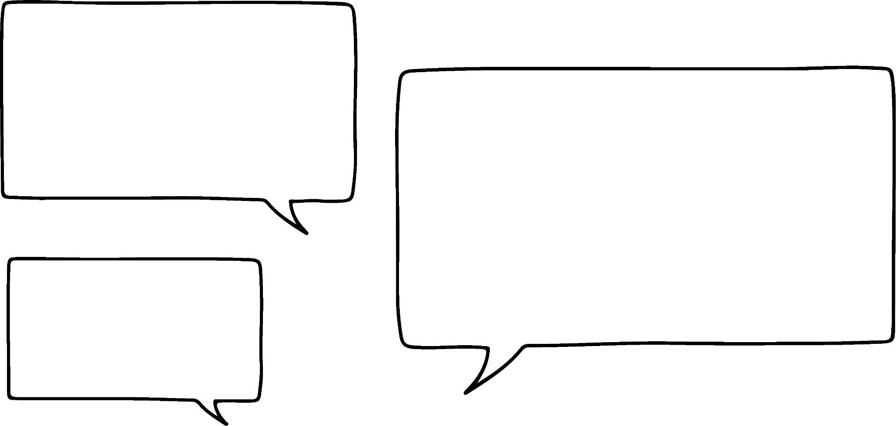


Using a graphical representation
Our Oak students are discussing an arithmetic sequence.
I’ve worked out the first ten terms of 91 − 17n.
They are 74, 57, 40, 23, 6, −13, −30, −47, −64, −81, …
I’ve checked the 10th term.
n = 10
91 − 17(10) = 91 − 170 = −79
I think you’ve made a mistake somewhere!
Alex
Aisha is correct.
But, can you spot where Alex made his error?
6 − 17 = −11
Aisha
−13 was the first error, then all subsequent terms are off.

Slide 19
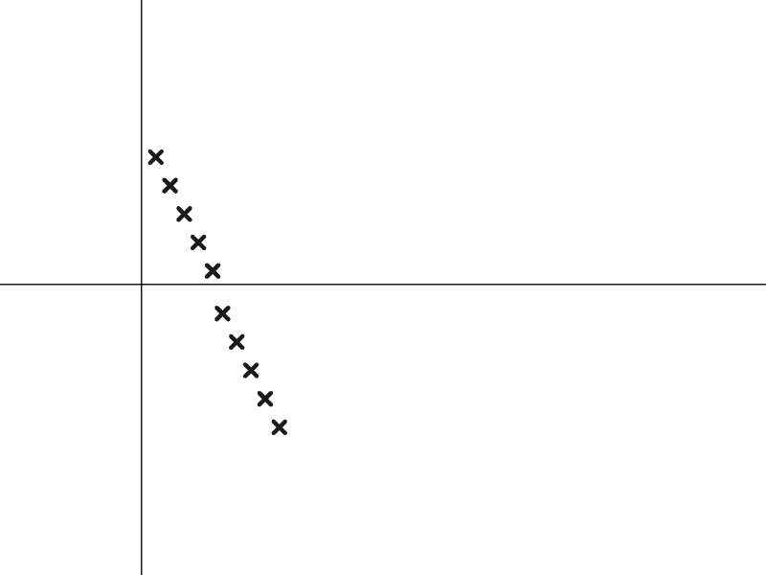
Using a graphical representation
Our Oak students are discussing an arithmetic sequence.
I’ve worked out the first ten terms of 91 − 17n.
They are 74, 57, 40, 23, 6, −13, −30, −47, −64, −81, …
Term value
Alex
If we had graphed Alex’s terms we could have seen the error more easily.
We can see the moment where, from the 6th term on, the sequence does not align so we can say −13 is not the 6th term of this sequence.
Term number

Slide 20

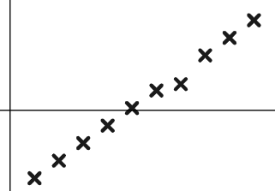
Using a graphical representation
Jun has written the first ten terms of the sequence −3.486 + 0.72n
Term value
He then graphs them and notices he has gotten one term wrong. Which term is it?
Term number
The 7th term is not in line.
1.094 must not be its value.

Slide 21
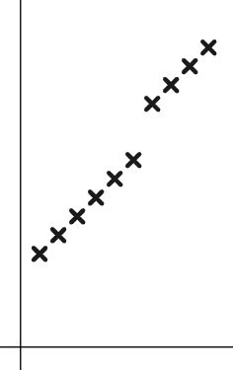

Using a graphical representation
1) Sam is asked to continue this arithmetic sequence and plot it.
127 850, 135 350, 142 850, …
They write the below values and plot them.
Term value
127 850, 135 350, 142 850, 150 350, 157 850, 165 350, 178 250, 185 750, 193 250, 200 750, …
Write a sentence explaining how you know there has been an error.
Term number

Slide 22
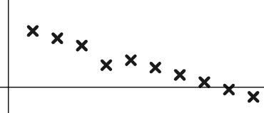
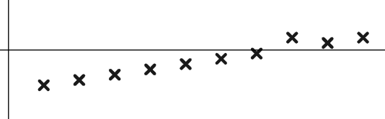
Using a graphical representation
2) Use the graphs to spot the incorrect terms in these arithmetic sequences.
a) 0.83, 0.72, 0.61, 0.3, 0.39, 0.28, 0.17, 0.06,−0.05,−0.16, …
Term value
Term number
b) −0.1,−0.85,−0.7,−0.55,−0.4,−0.25,−0.1, 0.35, 0.2, 0.35, …
Term value
Term number

Slide 23
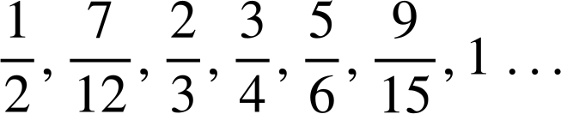
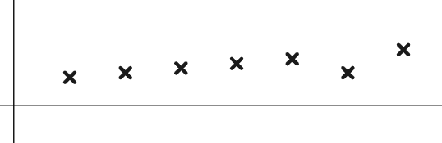

Using a graphical representation
2) Use the graphs to spot the incorrect terms in these arithmetic sequences.
c)
Term value
Term number
3) Laura is asked if the number 117 is in the sequence starting −8, −2, 4, 10, 16, …
She says:
“I’ll draw a graph and see if 117 is in line”
Write a sentence explaining why this might not be the most efficient method to use on this occasion.

Slide 24
Using a graphical representation
1) Sam is asked to continue this arithmetic sequence and plot it.
127 850, 135 350, 142 850, …
They write the below values and plot them.
Term value
127 850, 135 350, 142 850, 150 350, 157 850, 165 350, 178 250, 185 750, 193 250, 200 750, …
You might have written, “Arithmetic sequences plot in a straight line and on the 7th term the ‘line’ shifts” so there must have been an error here”.
Term number

Slide 25
Using a graphical representation
1) Sam is asked to continue this arithmetic sequence and plot it.
127 850, 135 350, 142 850, …
They write the below values and plot them.
Term value
127 850, 135 350, 142 850, 150 350, 157 850, 165 350, 178 250, 185 750, 193 250, 200 750, …
Whilst the graph shows you instantly there has been an error, you might also have noticed in the numbers they ended 850, 350, 850,... then shifted to 250. It was a calculator misread. The 7th term was 172 850.
Term number

Slide 26
Using a graphical representation
2) Use the graphs to spot the incorrect terms in these arithmetic sequences.
a) 0.83, 0.72, 0.61, 0.3, 0.39, 0.28, 0.17, 0.06,−0.05,−0.16, …
The 4th term is not in line.
0.3 must not be its value.
Term value
Term number
b) −0.1,−0.85,−0.7,−0.55,−0.4,−0.25,−0.1, 0.35, 0.2, 0.35, …
The 8th term is not in line. 0.35 must not be its value.
Term value
Term number

Slide 27

Using a graphical representation
2) Use the graphs to spot the incorrect terms in these arithmetic sequences.
c)
Term value
The 6th term is not in line.
must not be its value.
Term number

Slide 28
Using a graphical representation
3) Laura is asked if the number 117 is in the sequence starting −8, −2, 4, 10, 16, …
She says:
“I’ll draw a graph and see if 117 is in line”
Write a sentence explaining why this might not be the most efficient method to use on this occasion.
You might have included, “The term 117 will have quite a large term number if it is in the sequence, it would take a long time to plot this without technology.
It would be more appropriate, and certainly quicker, to use the odd/even features of this sequence to justify why 117 is not in this sequence”.

Slide 29
Justifying terms of a sequence
Using features of a sequence
Using a graphical representation
Using the n^{th} term

Slide 30
Using the n^{th} term
Beyond graphing with technology, or identifying features, there are other methods we can use to see if large numbers are terms in a sequence.
Is 607 in the arithmetic sequence starting 1, 7, 13, 19, … ?
We know the n^{th} term is 6n − 5
We can approximate that it is near the 100th term.
n = 100 6(100) − 5 = 595
From there we can count on. 595, 601, 607, … It’s the 102nd term.

Slide 31
Using the n^{th} term
Is −607 in the arithmetic sequence starting 2, −1, −4 … ?
Is −58 in the arithmetic sequence starting 851, 842, 833, 824, … ?
The nth term is 5 − 3n
The n^{th} term is 860 − 9n
−3 × 200 = −600 so approximately near the 200th term.
−9 × 100 = −900 so approximately near the 100th term.
n = 200 5 − 3(200) = −595
n = 100 860 − 9(100) = −40
Count on.
−595, −598, −601, −604, −607, …
Count on.
−40, −49, −58, …
200th
201st
202nd
203rd
204th
100th
101st
102nd
Yes. It’s the 204th term.
Yes. It’s the 102nd term.

Slide 32
Using the n^{th} term
What if that large number is not in our sequence?
What language do we use to justify the fact that it is not?
Is 841 in the arithmetic sequence starting 3, 7, 11, 15, … ?
The n^{th} term is 4n − 1 so 841 is approximately the 210th term.
n = 210 4(210) − 1 = 839
From there we can count on. 839, 843, 847, …
839 is the 210th term, 843 is the 211th term therefore 841 cannot be in the sequence.

Slide 33
Using the n^{th} term
Which best justifies that 295 in not in the arithmetic sequence starting −4, −1, 2, 5, … with n^{th} term 3n − 7 ?
You know at this point but, you haven’t justified that the next term is beyond 295
n = 100 3(100) − 7 = 293 so it’s not.
…, 290, 293, 296, 299, …
You haven’t justified that any of these terms are in our sequence
3(100) − 7 = 293 and 3(101) − 7 = 296
The 100th term is 293, the 101st is 296 so 295 can not be in the sequence.

Slide 34
Using the n^{th} term
1) Use n^{th} term and approximation to find 400 in the arithmetic sequence starting 10, 23, 36, 49, …
2) Is 400 in the arithmetic sequence starting −22, −14, −6, 2, …
Write a sentence to justify your answer.
3) Is −12.75 in the arithmetic sequence starting 21.25, 20.9, 20.55, 20.2, … Fully justify your answer.

Slide 35
Using the n^{th} term
1) Use n^{th} term and approximation to find 400 in the arithmetic sequence starting 10, 23, 36, 49, …
The n^{th} term is 13n − 3
We can approximate that it is near the 30th term.
n = 30 13(30) − 3 = 390 − 3 = 387
Count on. 387, 400, …
30th
31st
400 is in the sequence. It’s the 31st term.

Slide 36
Using the n^{th} term
2) Is 400 in the arithmetic sequence starting −22, −14, −6, 2, …
Write a sentence to justify your answer.
The nth term is 8n − 30 so 400 is approximately the 50th term.
n = 50 8(50) − 30 = 370
Count on: 370, 378, 386, 394, 402, …
394 is the 53rd term, 402 is the 54th term therefore 400 can not be in the sequence.

Slide 37
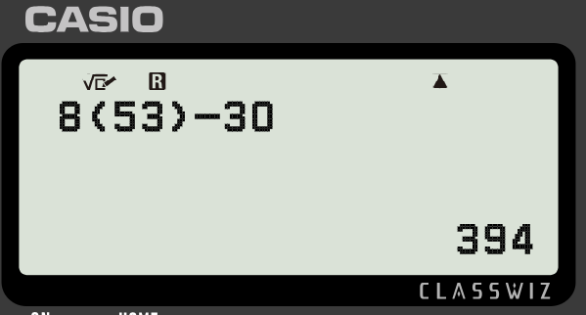
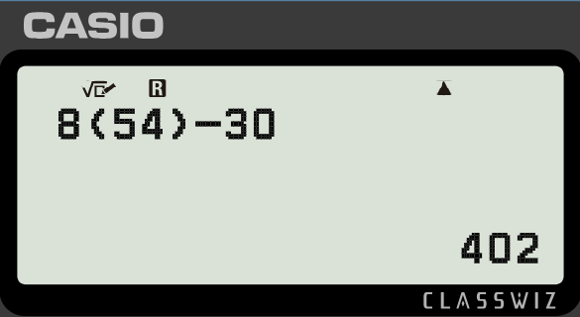
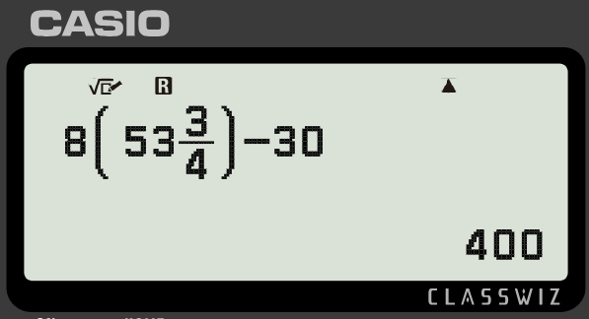
Using the n^{th} term
2) Is 400 in the arithmetic sequence starting −22, −14, −6, 2, …
Write a sentence to justify your answer.
The n^{th} term is 8n − 30
There is no whole number I can substitute in to 8n − 30 to make 400 and n, the term number, needs to be whole. It is not in the sequence.

Slide 38
Using the n^{th} term
3) Is −12.75 in the arithmetic sequence starting 21.25, 20.9, 20.55, 20.2, … Fully justify your answer.
The n^{th} term is 21.6 − 0.35n
21 − 35 = −14 so approximately the 100th term.
n = 100 21.6 − 0.35(100) = −13.4
Count back: −12.7, −13.05, −13.4 …
98th
99th
100th
−12.7 is the 98th term, −13.05 is the 99th term therefore −12.75 can not be in the sequence.

Slide 39
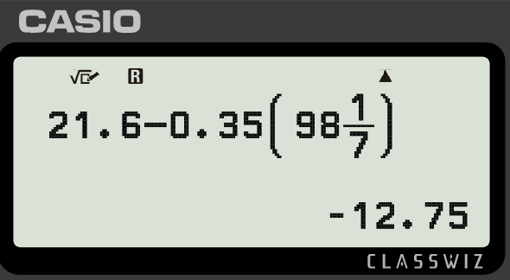
Using the n^{th} term
3) Is −12.75 in the arithmetic sequence starting 21.25, 20.9, 20.55, 20.2, … Fully justify your answer.
The non-whole value that makes −12.75 was difficult to find so it’s less appropriate to use this justification on this occasion.

Slide 40
Using the n^{th} term
I can determine whether a number is a term of a given arithmetic sequence in a variety of ways. By looking at the features of the sequence, by graphing it, and also by using the n^{th} term.

Slide 41

© Oak National Academy 2023.
Produced in partnership with Mathematics in Education and Industry.
Licensed on the Open Government Licence v3.0, except where otherwise stated. See Oak terms and conditions.

